Slide 1
Embedded Class 8
Interrupts and NVIC

Slide 2

Agenda
What is NVIC
Priority bits
CMSIS
Miscellaneous Interrupt Information
Stacks (PSP vs MSP)
PendSV Interrupt
SVC Interrupt
Exception Handling
Saving Registers to Stack
Lazy Stacking
Exception Status Registers
EXEC_RETURN

Slide 3


NVIC
Nested Vectored Interrupt Controller
Arm Cortex based peripheral
Allows interrupts to be called (nested) inside other interrupts based on priorities

Slide 4


Priority Bits
ARM specifies that their be at least 2 bits for the M0/M0+ and 3 bits for the M3/M4/M7
Note that many drivers expect the priority bits to be unshifted values
The NVIC on the M3/4/7 parts allow the programmer to break up the NVIC priority bits such that some can be used for sub-priority bits.

Slide 5
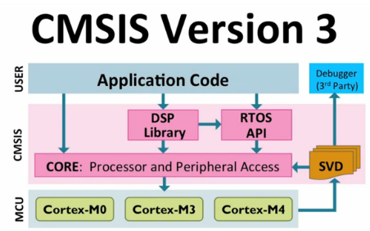
CMSIS
Cortex Microcontoller Software Interface Standard
CMSIS contains many macros and functions to interface with the Cortex core.
compliant libraries have defined __NBIC_PRIO_BITS to contain the number of bits used for the interrupt priorities.

Slide 6
NVIC Registers
NVIC_ISER (Interrupt Set Enable Register): enable interrupt bit, one bit for each interrupt
NVIC_ICER (Interrupt Clear Enable Register): disable interrupt bit, one bit for each interrupt
NVIC_ISPR (Interrupt Set Pending Register): mark interrupt as pending bit, one bit for each interrupt
NVIC_ICPR (Interrupt Clear Pending Register): clear pending flag bit, one bit for each interrupt
NVIC_IPRx (Interrupt Priority Register): interrupt priority (8bit for each interrupt, 4 interrupts are in each 32-bit register)
NVIC_IABR (Interrupt Active Bit Register): set if an interrupt is running, one bit for each interrupt, not available on the Cortex M0

Slide 7
Miscellaneous Interrupt Information
When the core boots up the interrupts are disabled, except for the Reset, NMI, and Hard Fault interrupts. To enable other interrupts the function __enable_irq() can be called, to disable other interrupts use __disable_irq().
When an interrupt is called the ICSR (Interrupt Control and State Register) will place which vector is executing in the VECTACTIVE bits. This value is also stored in the first 8 bits of the IPSR (Interrupt Program Status Register). To obtain the CMSIS interrupt number subtract 16 from this number. If the raw value of the register is zero then no interrupt is currently active. This is a handy means to determine if a function is called from and interrupt or not.
When might you want to know if an interrupt is active?

Slide 8
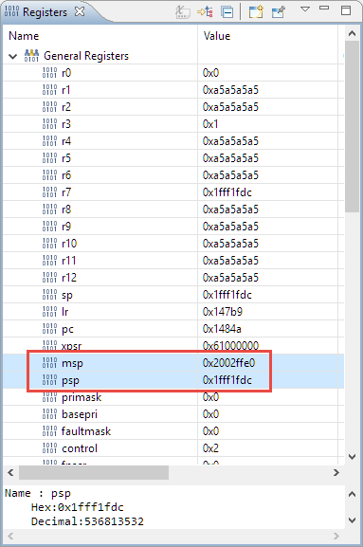
Stacks
Main Stack Pointer (MSP)
Stack used on reboot
Most common used stack for code without RTOS
With RTOS this would be the Kernel Stack
Used for interrupts
Process Stack Pointer (PSP)
User/Thread stack with RTOS
More about the MSP/PSP when we get to RTOSs

Slide 9
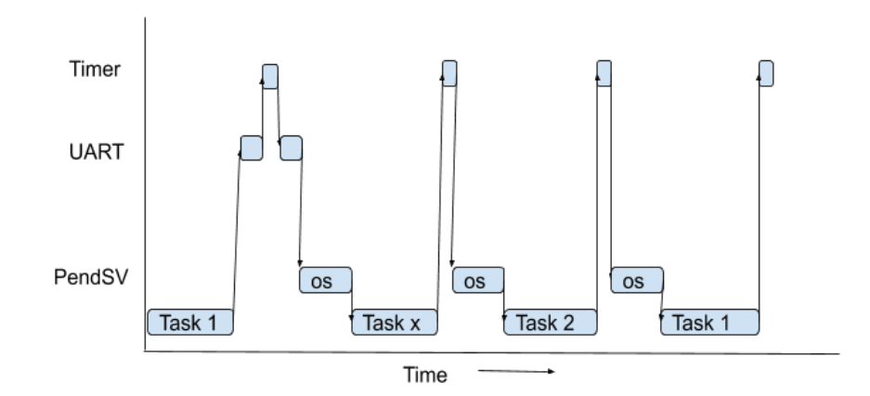
PendSV Interrupt
The Pendable SerVice is an interrupt that can be triggered by software only. This interrupt is often used by RTOS to handle context switching.
Usually the lowest priority interrupt

Slide 10
SVC Interrupt
The Supervisor interrupt is a software interrupt where you can pass a byte of data. ARM added this with the expectation that it might be used to call drivers. For example to transmit data via a UART you could put data in buffer and then trigger the SVC with a number for the UART. This way different chip vendors could all support the same application by changing the drivers and calling them through the SVC interrupts and run in the privilege mode of the processor.

Slide 11
Exception Handling
When an exception occurs, the cortex processor will automatically do certain operations specifically it will:
Save some registers to stack
Setup status registers
Set the EXEC_RETURN in the Link Register (LR)
Possibly change execution mode (privileged mode)
Possible switch stack (PSP / MSP)
Get PC from vector table
Execute the interrupt service routine
Reverse process to return

Slide 12
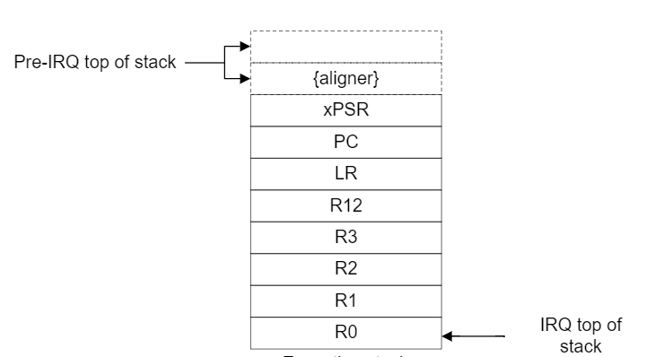
Saving Registers to Stack
Assuming that the floating point hardware is disabled (or not available) the following registers are pushed onto the stack.

Slide 13
Lazy Stacking
If the floating point hardware is enabled, Control Register’s FPCA bit, then additional registers may be pushed to the stack depending on the Floating Point Context Control Register (FPCCR) settings for lazy stacking enabled (LSPEN) and automatic state preservation enable (ASPEN) bits.
LSPEN | ASPEN | Operation
0 | 0 | Floating point registers not saved on stack
0 | 1 | Floating point registers pushed to stack
1 | 1 | Lazy stacking enabled (see below)
1 | 0 | Invalid option

Slide 14
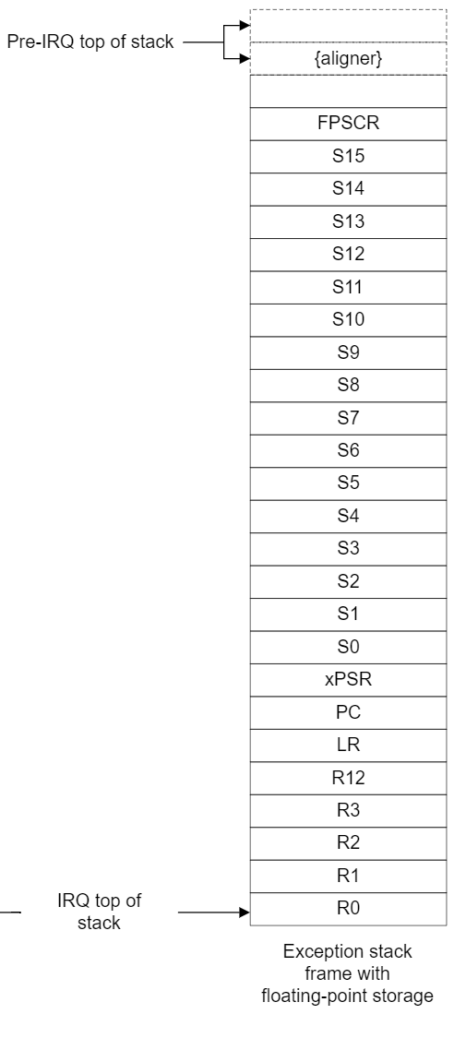
Lazy Stacking
When the floating point registers are pushed onto the stack the stack becomes:
Lazy stacking is a special case where the processor will reserve space on the stack for S0-S15 but not actually push the registers to the stack to save time. Then during the exception if the floating point registers are used, it will at that point push the floating point registers to the reserved space and claar the lazy stacking state preservation active (LSPACT) bit in the floating point status control register (FPSCR) to indicate that the floating point state changed. Then when returning from exception if the LSPACT bit is cleared the floating point registers are popped, if not they are skipped to save time.

Slide 15
Exception Status Registers
When an exception happens several things internally happen including:
Clear any state information for the LDREX and STREX synchronization instructions (M3 and above)
Set the exception number in the Interrupt Program Status Register bits (IPSR)
The core also modifies some system control state (SCS) registers

Slide 16
EXEC_RETURN
EXC_RETURN | Stack Pointer | Frame Type | Execution Mode
0xFFFFFFF1 | Main | Basic | Handler (privileged)
0xFFFFFFF9 | Main | Basic | User/Thread
0xFFFFFFFD | Process | Basic | User/Thread
0xFFFFFFE1 | Main | Extended (floating point) | Handler (privileged)
0xFFFFFFE9 | Main | Extended (floating point) | User/Thread
0xFFFFFFED | Process | Extended (floating point) | User/Thread
The LR register is normally the return address when a function (assembly BL or BLX instruction) is called. Since the LR is saved to the stack and we might call functions from the interrupt handler the cortex uses the LR to store state information. Specifically an interrupt can occur during any combination of the process executing the following states:
Privileged mode vs User/Thread mode
Main Stack Pointer (MSP) vs Process Stack Pointer (PSP)
Floating Point Stack Enabled vs Floating Point Stack Disabled
When the processor has the floating point hardware enabled in the FPSCR register the processor will automatically push the floating point registers (S0-S15) and the FRSCR onto the stack.
During an interrupt handler an RTOS may change the EXEC_RETURN to switch between execution modes and stacks.

Slide 17
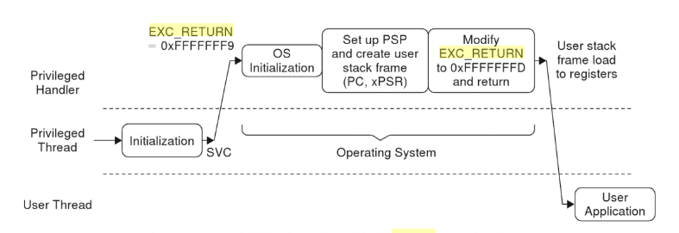
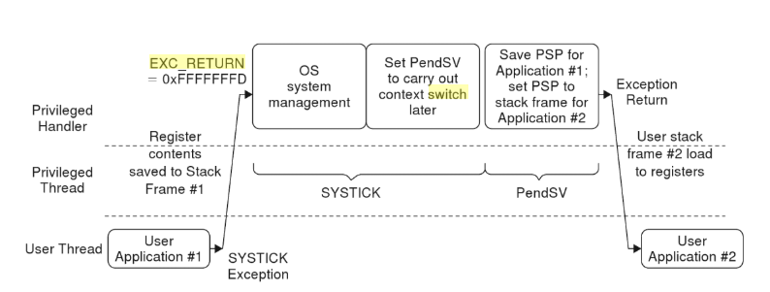
EXEC_RETURN

